Slide 1
Data Science Prototype
-By Darshit Nathani

Slide 2
Agenda
1
Concepts
2
Code

Slide 3
Concepts
1
Data processing
2
Machine learning Models
3
Feature selection

Slide 4
Data processing
Need
CSV contains features and target together.
CSV can contain string column values whose mapping is not defined
CSV can contain junk data (unwanted char, NAN ,NULL)
Data needed for training and testing is float type values
Splitting CSV to Train and Test sections.

Slide 5
Machine learning Models
1
Decision Tree
2
KNN

Slide 6
Decision Tree
Weight | Surface | Classification
140 | Smooth | Apple
130 | Smooth | Apple
150 | Bumpy | Orange
170 | Bumpy | Orange
Weight >= 150 g
Is it Bumpy?
Yes(Orange)
No(Apple)
Apple

Slide 7
KNN(K Nearest Neighbors)
Height | Weight | Classification
120 cm | 50 kg | Labrador
130 cm | 57kg | Labrador
70 cm | 30 kg | Street Dog
80 cm | 35 kg | Street Dog

Slide 8
Feature selection
Need
To reduce processing time
To reduce Training time
To increase Accuracy
To reduce model file size
Types
RFE
Chi-squared
PCA

Slide 9
Code
1
Data processing
2
Data Filtering
3
Train Model
4
Save Model
1
Predict Result

Slide 10
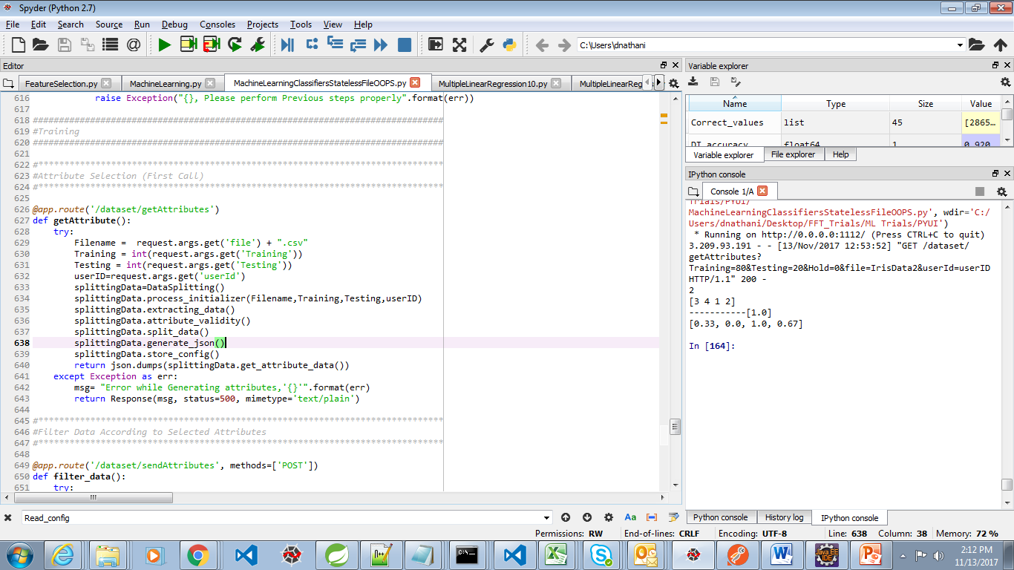
Data processing
1
Initializing
2
Extracting Data
3
Attribute Selection
4
Splitting Data
5
Creating JSON
6
Store Configuration data

Slide 11
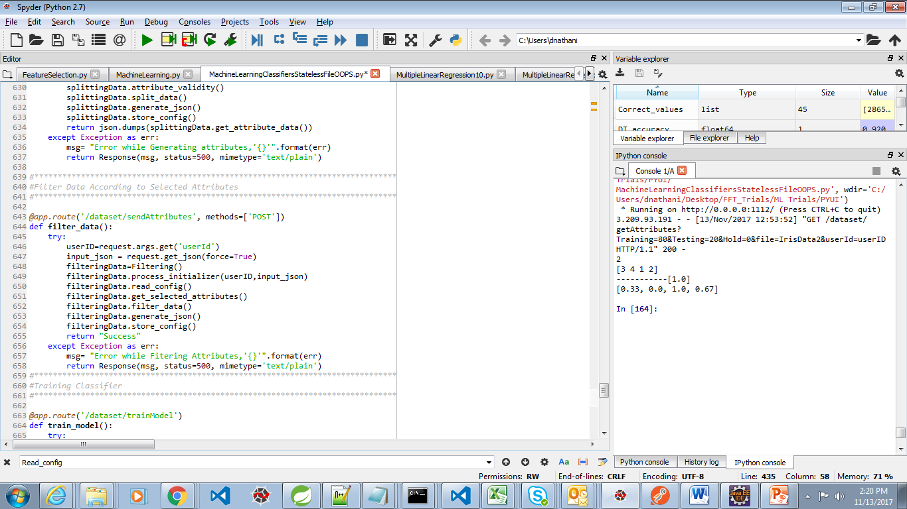
Data Filtering
1
Initializing
2
Read Configuration data
3
4
Extract Selected Attribute
5
Creating JSON
6
Store Configuration data
Get Required columns

Slide 12
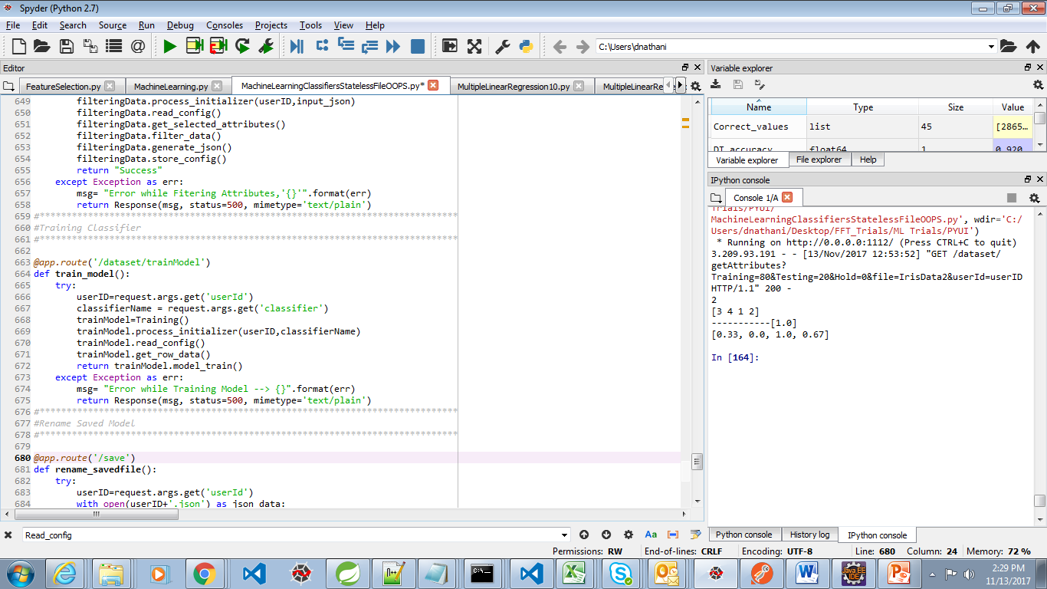
Train Model
1
Initializing
2
Read Configuration data
3
4
Train Selected Model
Get Training and Testing data

Slide 13
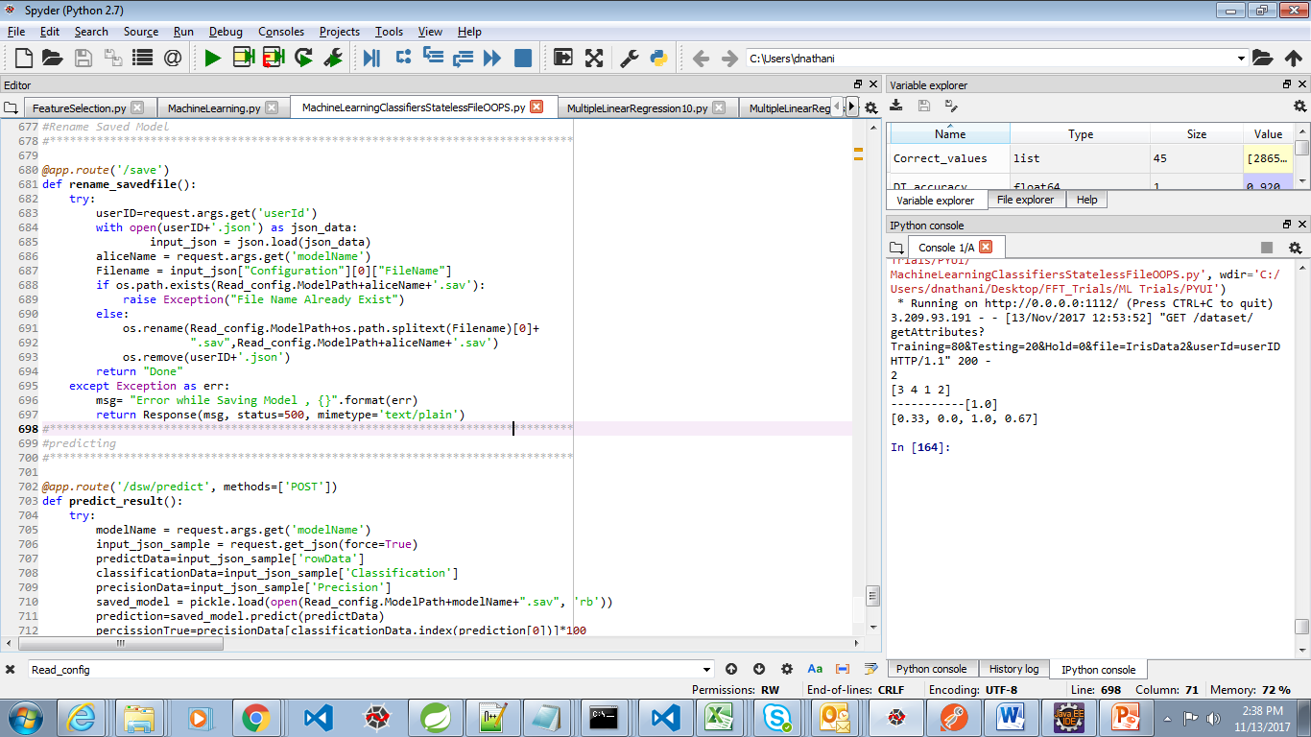
Save Model
1
Check If File Exist
2
Save Model with Required Name
3
4
Delete CSV File
Delete Configuration File

Slide 14
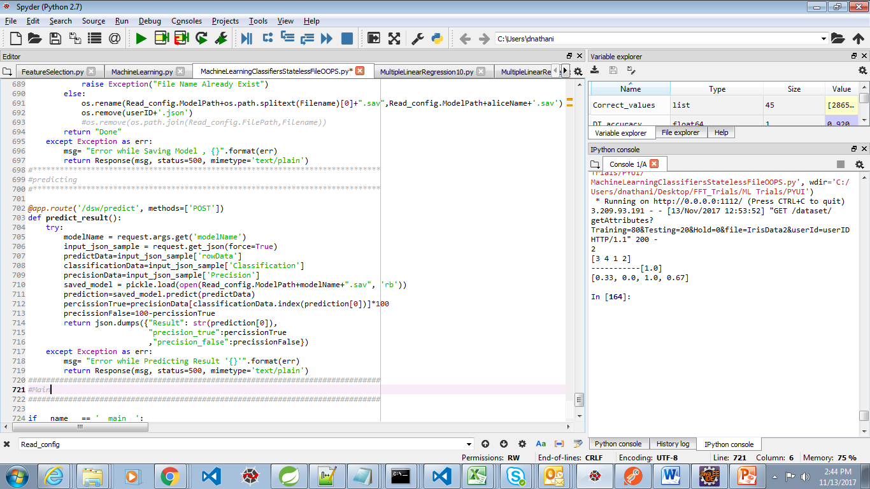
Predict Result
1
Open Model File
2
Predict Result
3
4
Create JSON
Calculate True and False Precision for selected Class

